Slide 1
DABAB ضباب
TDRA HACKATHON 2026 · GCAA CHALLENGE PROFILE #3
An AI copilot for air traffic control in fog. The AI predicts, plans and explains. The human decides.
Ali Eissa · Mohammed Hishaam · Responsible AI & Smart Cognitive Government · Aviation Safety · AI-Enabled Innovation
Notes:
Opens after the 10-second video. Say: "That controller is not fiction. This is DABAB."

Slide 2
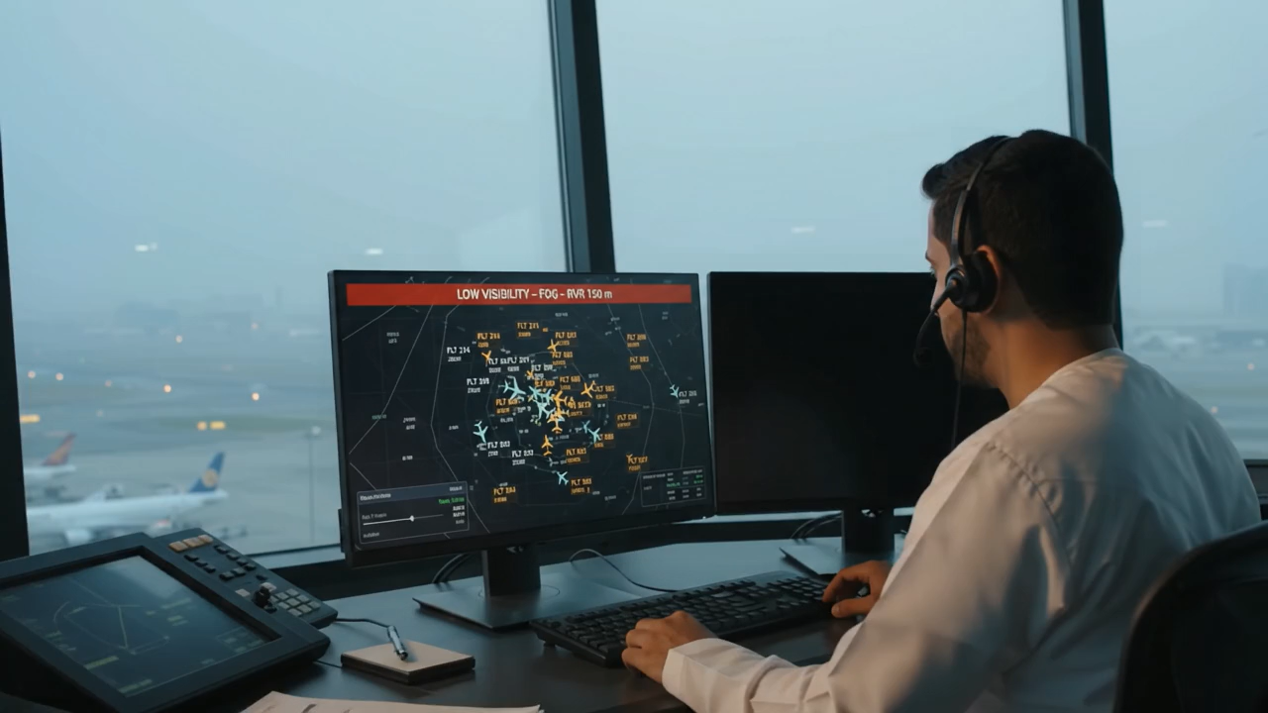

Slide 3
When fog hits Dubai, controllers re-plan dozens of flights by hand, in minutes
THE CHALLENGE · GCAA CHALLENGE PROFILE #3
Average arrival delay in fog at DXB
86 min
Capacity collapses
3 Jan 2026: visibility 193 m, landings fell from 28 to 15 an hour.
Systems don’t talk
Air navigation, the airport and airlines each see only their part.
Trade-offs are hidden
Less delay can mean more fuel burned holding; no one sees the cost.
vs 11 min on normal days
Data: Dubai Airports flight information, 282,705 arrivals (May 2025 – Nov 2026), Data.Dubai · OMDB METAR · 5 fog events
Notes:
That morning was real. On 3 January, fog closed Dubai International. Across 18 months of Dubai Airports data, fog days average 86 minutes of delay, against 11 on normal days. Controllers decide who holds, who diverts and where, by hand, with three systems that don’t talk.

Slide 4
The AI predicts, plans and explains. The human decides.
THE SOLUTION
GCAA · Challenge Profile #3
Responsible AI & Smart Cognitive Government
Aviation Safety
AI-Enabled Innovation
1 · Predict
2 · Prioritise
3 · Plan
4 · Explain
5 · Decide
AI fog model warns hours ahead
Controller picks delay, fuel, diversions or connections
Three ranked plans in seconds: holds, diversions, stands
Why, cost, why not the others, in Arabic and English
Human approves; one plan to tower, airport, airlines, cockpit
Built for the challenge
✔ Immediate, reliable decisions: plans in seconds, reliability on every plan
✔ Landing stands: 220 official DXB stands, size enforced, zero conflicts
✔ Air navigation + airport integration: one approved plan for all
✔ UAE direction: National AI Strategy 2031, safer and greener aviation
Government open data
Data.Dubai: 282,705 Dubai Airports arrivals
GCAA eAIP: 220 stands, runways, ILS for 7 airports
METAR: 7 UAE airports since 2014
Notes:
This is GCAA’s Challenge Profile 3, under Responsible AI, Aviation Safety and AI-enabled innovation. DABAB is a decision copilot for controllers. It warns before the fog, builds three recovery plans in seconds, explains each in Arabic and English, and a human always approves. It answers the challenge line by line, and it runs on government open data: Dubai Airports flights, the GCAA aeronautical publication and airport weather reports.

Slide 5
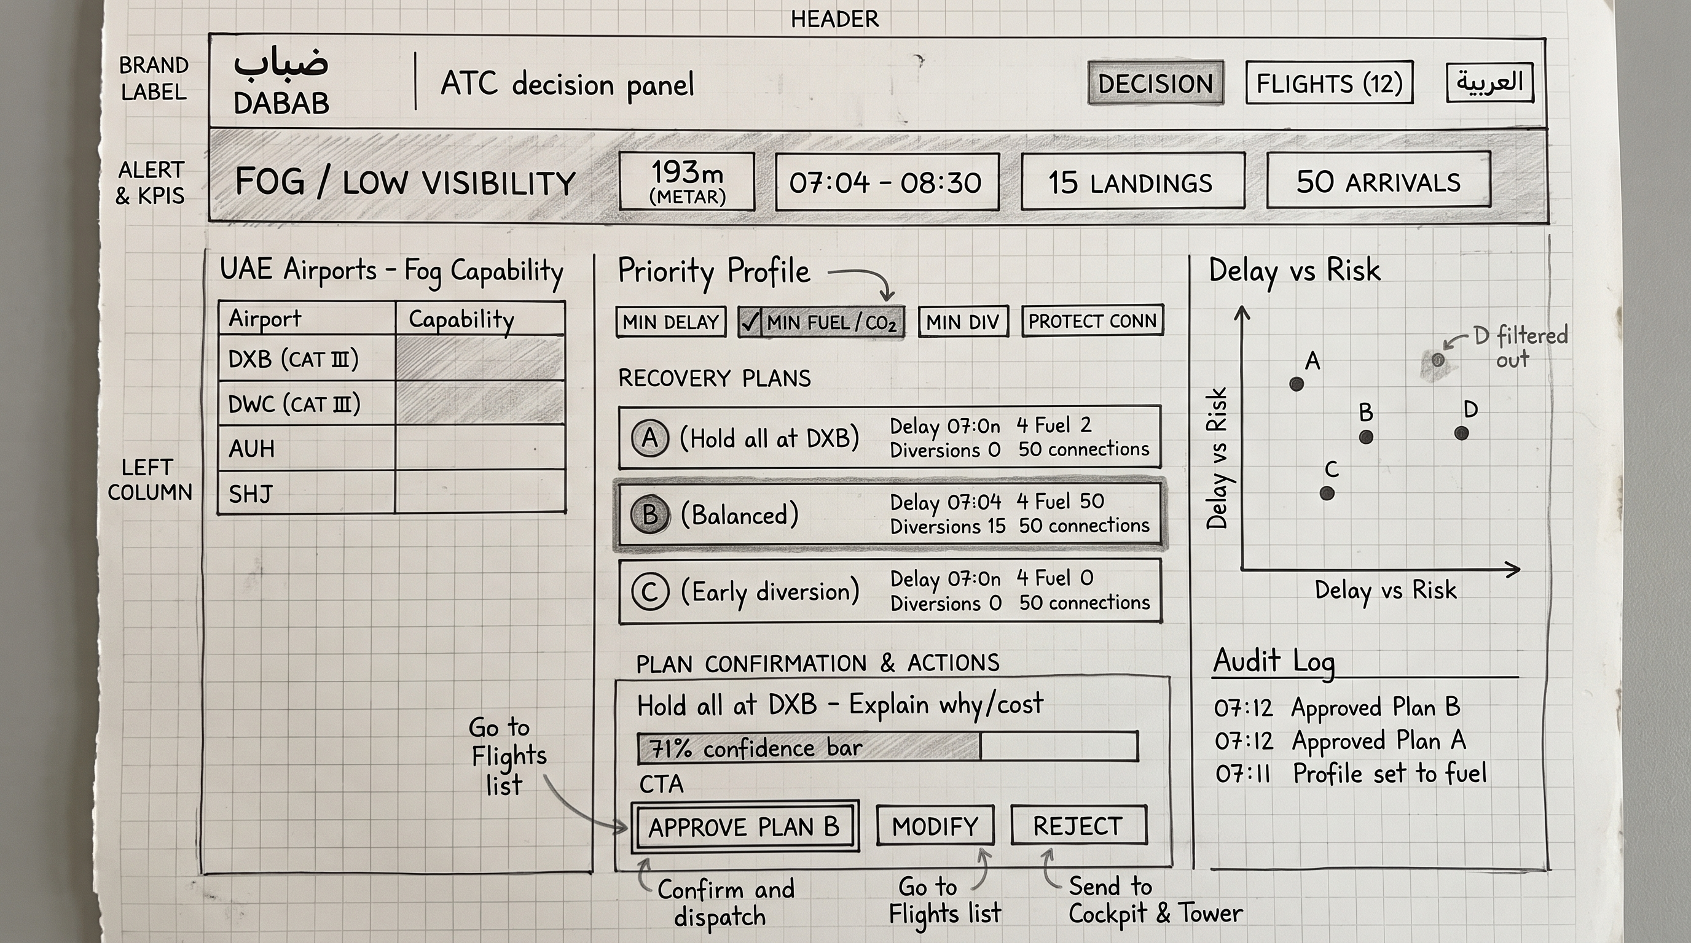
Two builders, one working system on real data
THE TEAM
Ali Eissa
Engine and AI: data, fog model, optimizer, explanations, backend
Mohammed Hishaam
Product and pitch: ATC panel, user journey, business model
“Fog is the UAE’s most disruptive weather for aviation, and the decision is still made by hand.”
Wireframe → working panel with live backend
282,705 arrivals · 220 GCAA stands · fog model on 12 years of METAR
Notes:
We are two people. In this hackathon we went from a paper wireframe to a working system on real data. (Switch to the live dashboard.)

Slide 6
3 January 2026, 07:12.
Fog over DXB.
LIVE DEMO
Predict → Prioritise → Plan → Explain → Approve, on the real flights and weather of that morning.
Notes:
Switch to the dashboard (backup: screen recording). 1) Header: the AI fog model raised a Watch at 01:30, five and a half hours before fog hit at 07:04; on the right, the real weather reports. 2) Click Minimum fuel: the controller chooses the priority; safety rules never change. 3) Plans: three plans with delay, diversions, fuel, connections and reliability. In our replay, against no coordination, the recommended plan cuts holding and diversion fuel by 37% and the risk index by 24%. 4) Click plan C: why this plan, what it costs, why not the others, written by the AI using only the engine’s numbers. 5) Approve: one click sends the plan to tower, airport stands, airline ops and the cockpit, and it is logged. The human decides.

Slide 7
Three AI layers, each one checkable
INNOVATIVE USE OF AI
Predict
Plan
Explain
Machine-learning fog model on 12 years of METAR from 7 UAE airports
Optimizer re-sequences 185 arrivals, holds flights at origin, balances diversions across UAE airports
Grounded LLM writes each reason in Arabic and English
95% of unseen fog events warned, ~4 h notice
5 h 34 min before the 3 Jan fog
Every number is checked against the engine; one invented number, rejected
Hard safety rules: fuel reserve, stand size, ILS minima, A380 limits
Responsible by design: a human approves every plan, and every decision is logged.
Notes:
Three AI layers: a fog prediction model trained on twelve years of airport weather, which warned of 95% of fog events it had never seen; an optimizer with hard safety rules; and a language model that explains, but can only quote numbers the engine produced.

Slide 8
Same safety, less fuel, fewer diversions
THE IMPACT · IN OUR REPLAY OF 3 JAN 2026
−37%
−24%
−40%
5h34
holding and diversion fuel
335 t → 212 t
risk index
diversions, 10 → 6
(fewest-diversions plan)
fog warning before the fog
Validated: on 10 Feb 2026 our no-coordination simulation reproduces the real day: 28 vs 28 diversions, 56.9 vs 57.2 min delay.
Vs no coordination, same simulation, on real flights, weather and stands. Fuel reserves and connecting passengers are synthetic. Indicative; to be confirmed in the 90-day trial.
Notes:
In our replay of the real 3 January morning, DABAB’s plan used 37% less holding and diversion fuel than an uncoordinated plan in the same simulation, and cut risk by a quarter. The flights, weather and stands are real data; the simulation reproduced a real fog day, 10 February, almost exactly. So we present these as indicative results, and the 90-day plan is how we prove them with controllers. If a judge asks “are these real?”: the weather, flights and stands are real government data; the fog model was tested on years it never saw; the plan savings come from a simulation that reproduced a real fog day almost exactly.

Slide 9
Business model canvas
THE BUSINESS MODEL
Key partners
Key activities
Value proposition
Relationships
Customers
GCAA · dans · Dubai Airports · airlines · NCM · Digital Dubai · TDRA
Live data feeds · tune rules with controllers · replay every weather day
Ranked recovery plans in seconds, not manual juggling · delay, fuel, CO₂, diversions, reliability per plan · Arabic and English reasons · human approves, all logged · one shared picture
Co-designed with controllers · shadow mode first · review after each event
Pays: dans, under GCAA; airports co-buy
Users: controllers, airport and airline ops
Later: UAE and Gulf airports
Key resources
Channels
Open data · engine, fog model, LLM, panel · team + ATC advisor
GCAA-led pilot at DXB · layer on A-CDM · then UAE and Gulf
Costs
Revenue and funding
A-CDM / AODB integration (largest) · safety assurance · controller time · hosting
Annual licence per airport (SaaS) + integration · GCAA / TDRA pilot first
Notes:
Here is the full model; the next slide has the three points that matter.

Slide 10
Who pays, how we earn, how it scales
MARKET POTENTIAL
Who pays
How we earn
How it scales
dans, Dubai’s air navigation provider, under GCAA. Airports co-buy; airlines benefit.
Annual licence per airport (SaaS) plus integration and training. Year one: GCAA / TDRA pilot.
DXB first, then 6 more UAE airports, then fog-prone Gulf airports. Same engine.
~123 t
of holding fuel saved on one fog morning at DXB in our replay (≈390 t CO₂)
Fuel saving from the 3 Jan 2026 replay vs no coordination (simplified simulation).
Notes:
The air navigation provider pays an annual licence per airport, with airports as co-buyers. We start at DXB and scale to every UAE airport with the same engine. In our replay, one fog morning saved about 123 tonnes of fuel; we will confirm real savings in the trial.

Slide 11
It already runs. What remains is integration and approval.
FEASIBILITY
Built and working today
What it needs
Pipeline on real open data (282,705 arrivals, 220 stands)
Fog model tested on unseen data
Engine validated against a real fog day
Working panel, backend, audit log, hand-off message
Data: live Dubai Airports API (requested) + NCM feed
Integration: read-only A-CDM / AODB link; advisory only
Approval: GCAA safety case for a suggestion-only trial
Team: 2 builders + 1 ATC advisor
Risks → mitigations: low trust → shadow mode and drills · slow data access → replay and simulation · safety → advisory only, human approves
Notes:
Most of the hard part already works on real data. What remains is data access, read-only integration and GCAA approval, and DABAB only advises, so nothing in today’s systems has to change.

Slide 12
90 days: from prototype to a GCAA go / no-go
THE PATHWAY
DAYS 1–30
DAYS 31–60
DAYS 61–90
Secure and compliant
Beyond fog, open to others
Test: simulated, then real
Wk 1–2: code review, tests, CI, access roles, signed audit log
Wk 3: UAE data residency, security review
Wk 4: safety case (DO-278A / ED-109A practice)
Wk 5–6: live Dubai Airports API + NCM feed; retrain fog model
Wk 6–7: thunderstorms and dust, same engine
Wk 7–8: secure endpoint: external systems and AI apply only human-approved plans
Wk 9–10: replay every fog and storm day since 2025
Wk 11: fog drills with 5+ controllers in a simulator
Wk 12: shadow mode at DXB with GCAA approval; else extended simulation
Exit: security review passed · zero safety-rule violations in all replays
Exit: ≥ 90% of fog events warned ≥ 2 h ahead · endpoint works in a sandbox
Exit: ≥ 70% of plans accepted in drills · GCAA go / no-go
Notes:
Ninety days, three phases, each with a measurable exit test. First make it secure and compliant. Then connect live data, extend it beyond fog, and open a secure endpoint so other systems can apply approved plans. Then test it: every past weather day, drills with controllers, and shadow mode at DXB if GCAA approves.

Slide 13
When the weather changes, nobody should have to guess.
DABAB: the AI predicts, plans and explains. The human decides.
Ali Eissa · Mohammed Hishaam · TDRA Hackathon 2026 · GCAA Challenge Profile #3
Notes:
Fog will come back to Dubai. With DABAB, the next time, the plan is ready before the fog is. Thank you.

